Slide 1
DEPI Incident Response Track
Vulnerability Assessment Project

Slide 2
Vulnerability Assessment
Identify and assign security Weaknesses
What was secure yesterday may not be secure today
New software vulnerabilities discovered everyday
Proactive patch management
scan should be periodic

Slide 3
Vulnerability Assessment Cont.
We are performing the VA
Regarding Assessment plan:
For servers that are replicated on more than one site, we can choose one site and apply the finding to the others.
For servers with the same function on the same site, we are going to apply the same approach (Scan one server and apply the findings to the other servers)

Slide 4
Vulnerability Assessment preparation
On 15-9-2024
We are performing the VA through Tenable Nessus scanner
Nessus Scanner is a popular vulnerability assessment tool designed to help organizations identify and mitigate potential security risks in their network infrastructure. Developed by Tenable, Nessus performs automated scans to detect vulnerabilities such as missing patches, configuration issues, and exploitable flaws across a wide range of systems including servers, network devices, firewalls, and applications.

Slide 5
Vulnerability Assessment preparation
Cont.
The systems we assessed :
Ubuntu server
FortiGate Firewall
Our scope and objectives of the assessment:
put a remediation plan to fix and mitigate all the risks and vulnerabilities identified on the various systems

Slide 6
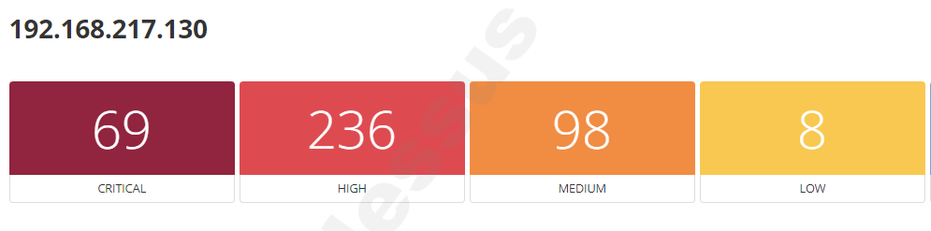
Conducting Vulnerability Assessment
on 26-9-2024
Started with Ubuntu server
OS: Linux Kernel 5.4.0-84-generic on Ubuntu 18.04
411
Total Vulnerabilities

Slide 7
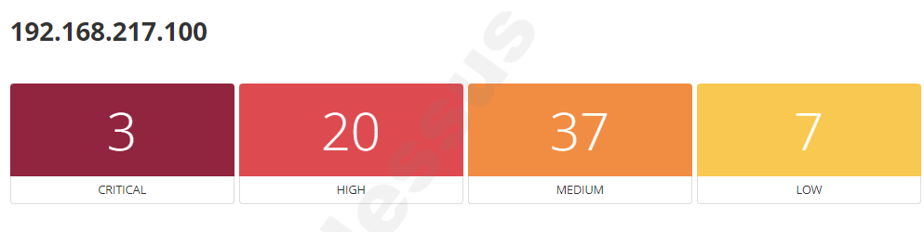
Conducting Vulnerability Assessment
on 26-9-2024 Cont.
Then FortiGate Firewall
OS: FortiOS 6.4.5, build 1828,210217
67
Total Vulnerabilities

Slide 8
Remediation Plan
We put a remediation plan for the assessed various systems
Ubuntu server: 2 phases for the remediation
First phase on: 28 September 2024 and the second phase to upgrade the server on 10 October 2024 to remediate most of vulnerabilities
FortiGate Firewall: 1 phase to upgrade the FG firewall

Slide 9
Remediation status after fixing issues
Now we have upgraded the Ubuntu server and FortiGate FW
Ubuntu Server: From Linux Kernel 5.4.0-84-generic on Ubuntu 18.04 to Linux Kernel 5.4.0-196-generic on Ubuntu 20.04
FortiGate Firewall: From FortiOS 6.4.5, build 1828,210217 to FortiOS 7.0.15,build0632,240401

Slide 10


Verifying fixes by conducting rescans
Ubuntu Server
96
236
98
1249
430
Total Vulnerabilities
After Rescan after remediation done on most of vulnerabilities
0
0
1
1
365
Total Vulnerabilities

Slide 11
Verifying fixes by conducting rescans
FortiGate Firewall
3
20
37
1249
60
Total Vulnerabilities
After Rescan after remediation done on most of vulnerabilities
0
0
2
2
365
Total Vulnerabilities

Slide 12

Thanks

